Slide 1

Presentation of Findings
September 17, 2026
SUNY Jefferson
Dr. Akanksha Misra
Mr. Joel LaLone
What Shapes (Women’s) Health in the North Country?
Exploring the Impact of Adverse Childhood Experiences in Rural Northern New York

Slide 2
Today’s Agenda:
Chapter 1 – The Study – What? Why? How?
Chapter 2 – What have we learned about North Country residents?
(A descriptive statistical presentation, many/most never before studied)
Chapter 3 – Adverse Childhood Experience (ACE) & Menstrual Health (MH) Metrics to reduce/collapse study results into manageable and meaningful measures. (based upon current literature and past studies)
Chapter 4 – Relationships/Modeling I Soc-Dem & Soc-Det ↔ ACEs
Chapter 5 – Relationships/Modeling II ACEs → Chronic Health Conditions, HC Access, & Mens. Health
Chapter 6 – Wrap-up Summary, Take-aways, Next Steps, Q/A

Slide 3
Chapter 1
The Study ─ What? Why? How?

Slide 4
What? Adult Community Survey - North Country Health and Healthcare
Survey completed in February 2026
Goal: learn North Country adult residents’ attitudes, opinions, and behaviors related health and healthcare, with particular emphasis on ACEs and menstrual health
Sample in Jefferson, St. Lawrence, Franklin, Essex, and Clinton Counties (300,000 adults in the population)
Sample Size: n=2,991 adult participants
Residents age 18+, not exclusively women
Mixed-mode methodology, AAPOR best practices: random email invitation online, random text message invitation online, and intercepts at FD.
Weighted toward population demographic parameters (within counties – Gender, Age, Education, Race, Military Affiliation (in only Jeff), and finally by sampling modality and, for the NC Region – by County Population Sizes
This representative sample includes 853 residents of Jefferson County, 580 from St. Lawrence County, 339 from Franklin County, 424 from Essex County, and 795 from Clinton County

Slide 5
What? Survey Sections
Interviews included total of ≈95 questions, comprised of 6 sections of survey questions.
Survey Sections:
Socio-Demographic Characteristics of Participants (9 Q)
Social Determinants of Health (4 Q)
Participants’ Health Conditions (12 Q)
Challenges Accessing Healthcare (9 Q)
Adverse Childhood Experiences (36 Q)
Menstrual Health (25 Q)

Slide 6
Why? ACE’s – Health Conditions – Menstrual Health – Healthcare Access - Rurality
Continuation of Menstrual Health study (expanded version)
Attempt to capture SDoH, ACEs, Menstrual, and Chronic Health connections in one survey
Rural Women’ Health
Extended ACEs relevant to rural areas
‘Care’ in Healthcare

Slide 7
How? Methodology
After weighting: ≈ (1/2) via email, ≈ (1/2) via MMS/SMS
In Jefferson, however, 15% via intercept
Design Effect ≈2.0 (very good considering the # weight factors)
Response rates incredibly high compared to current AAPOR industry standards (E=2-%3%, TM=4%-6%)
Margin of Error:
  approximately ±2.0% for the 2026 region-wide estimates
Margin of Error is larger than ±2.0% when investigating smaller subgroups (such as only one county, or only those who are low income, or North Country natives, etc.…)
Margins of Error for Varying Sample Sizes
Sample Size (n=…) | Approximate Margin of Error
30 | ±20.2%
50 | ±15.7%
100 | ±11.1%
150 | ±9.0%
200 | ±7.8%
250 | ±7.0%
300 | ±6.4%
339 | ±6.0%
400 | ±5.5%
424 | ±5.4%
500 | ±5.0%
580 | ±4.6%
795 | ±3.9%
853 | ±3.8%
1,000 | ±3.5%
1,500 | ±2.9%
2,000 | ±2.5%
2,500 | ±2.2%
2,991 | ±2.0%

Slide 8
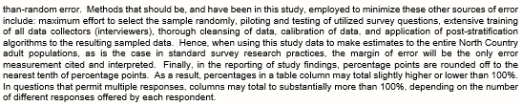
How? Methodology

Slide 9
Chapter 2
What have we learned about North Country residents?
A descriptive statistical presentation (many/most never before studied)

Slide 10
Off we go … for a peak at what we’ve learned …
REMINDER: Survey Sections:
Socio-Demographic Characteristics of Participants (9 Q)
Social Determinants of Health (4 Q)
Participants’ Health Conditions (12 Q)
Challenges Accessing Healthcare (9 Q)
Adverse Childhood Experiences (36 Q)
Menstrual Health (25 Q)

Slide 11
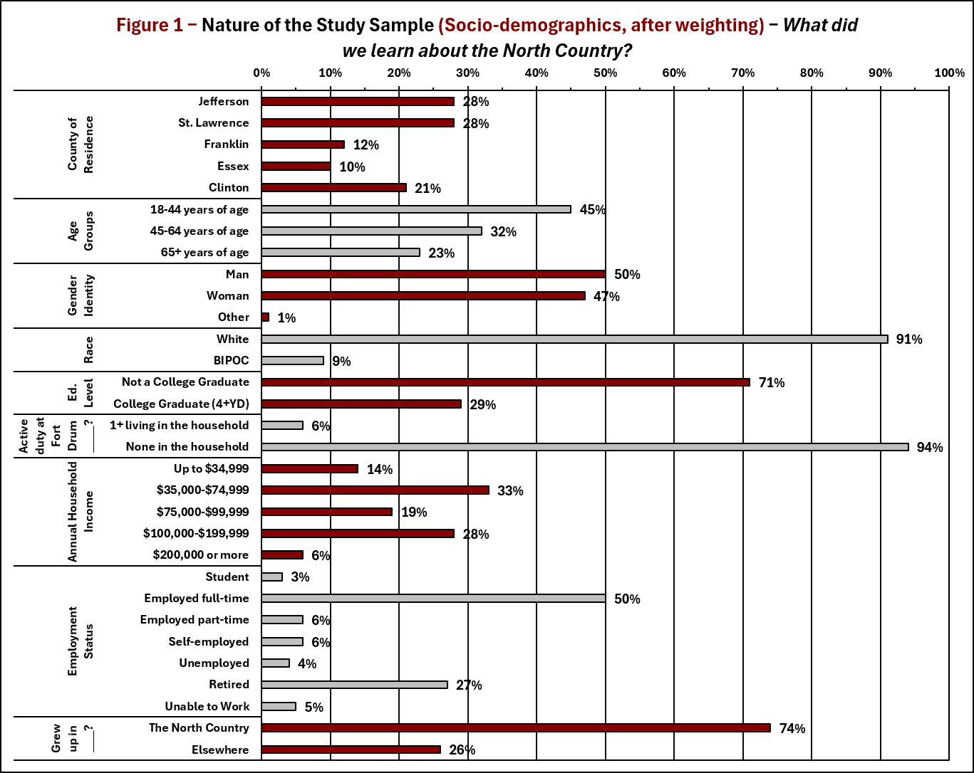
What did we learn? What did the sample “look like”, socio-demographically?
After post-stratification weighting to adjust for non-response bias (a plot of Table 54 from Appendix of Final Study Report).
9 Socio-demographic Q’s in the survey

Slide 12
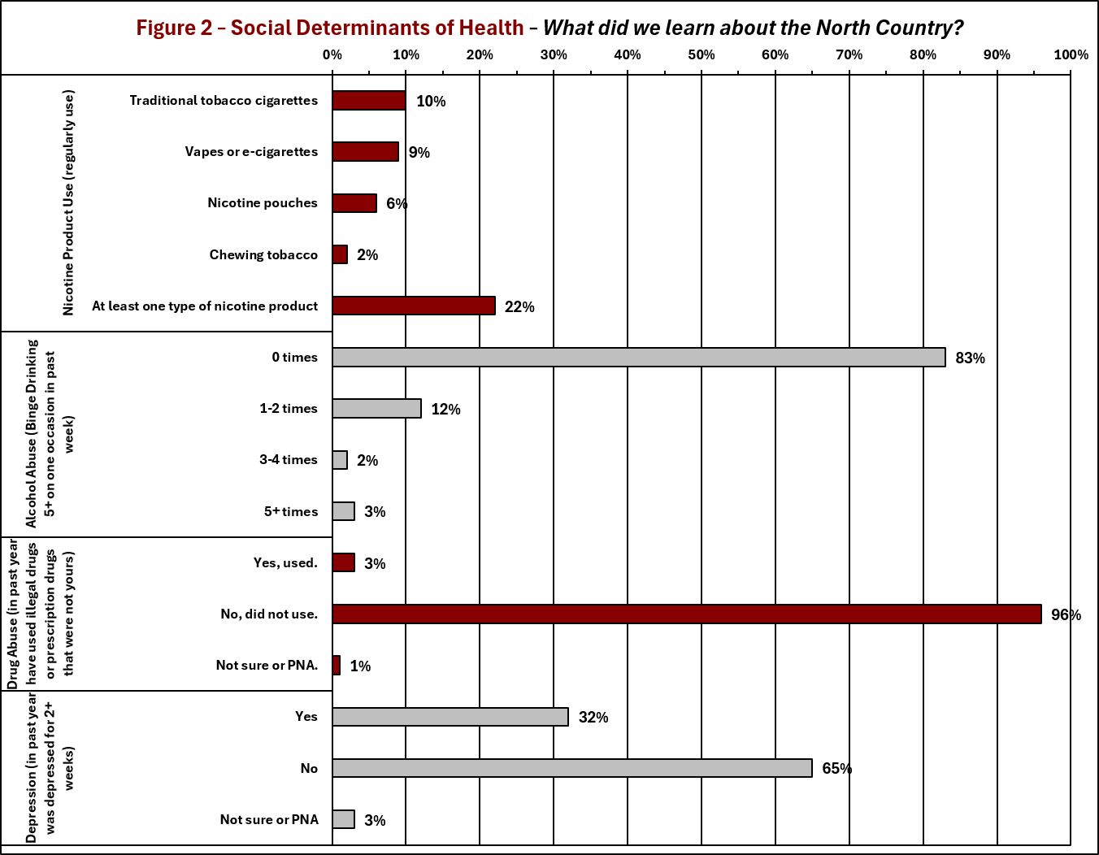
What did we learn? Social Determinants of Health in the North Country?
Among the preceding 9 Socio-demographic Q’s in the survey, several could be considered SDoH.
4 additional SDoH Q’s included in the survey

Slide 13
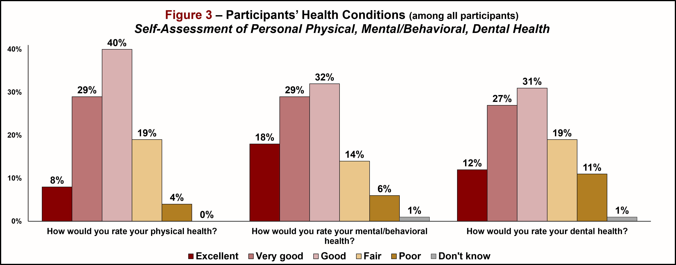
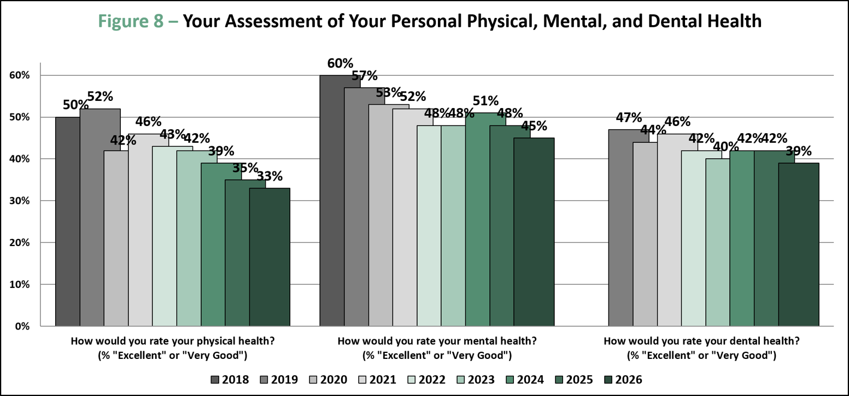

What did we learn? Participants’ Health Conditions (self-assessed) in the North Country?
12 Health Condition Q’s included in the survey (self-assessments, and chronic condition diagnoses)
(These are the 5-county results for this study, in February 2026)
(These are the local 3-county results for an annual community health survey completed by FDRHPO, most recent in July 2026)

Slide 14
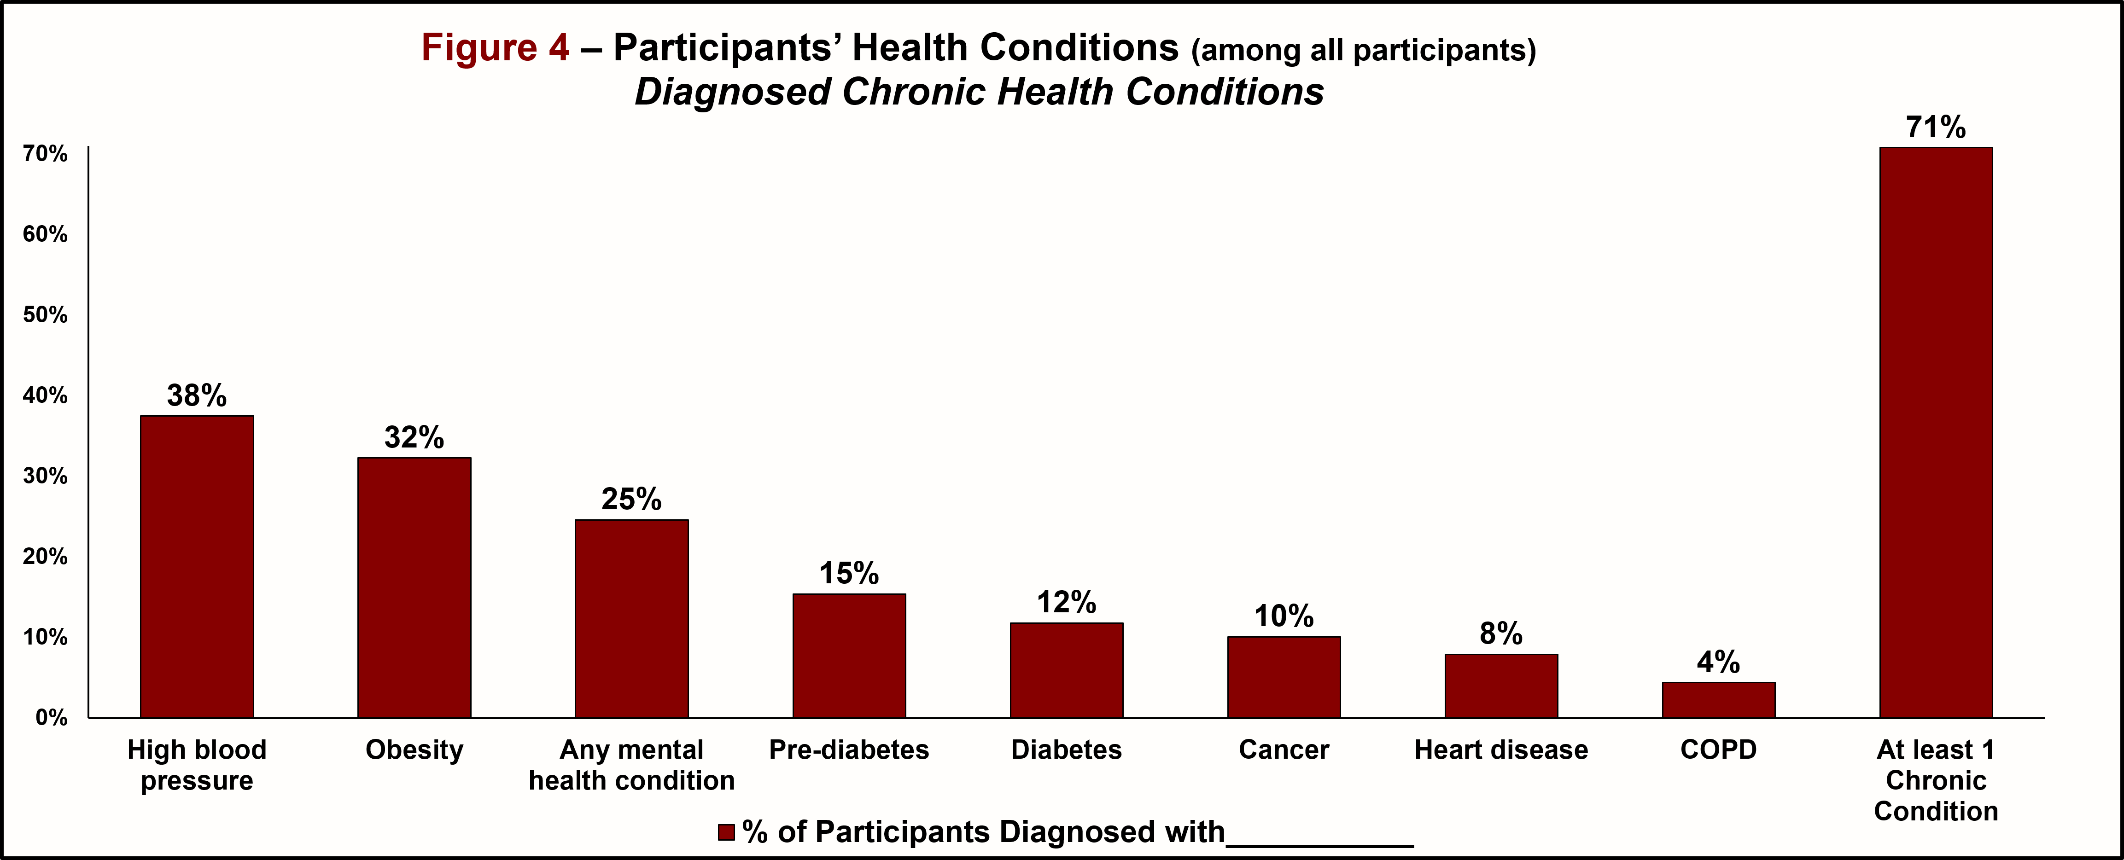
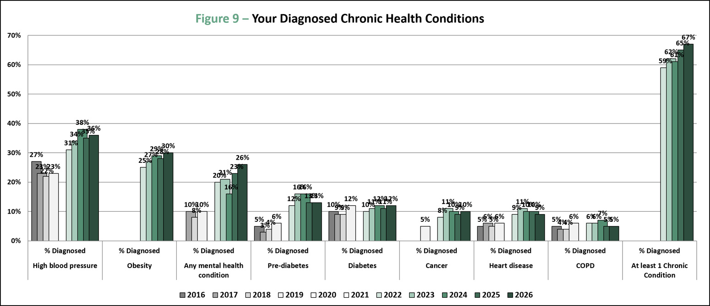
What did we learn? Participants’ Health Conditions (diagnoses with chronic conditions) in the North Country?
12 Health Condition Q’s included in the survey (self-assessments, and chronic condition diagnoses)
(These are the 5-county results for this study, in February 2026)
(These are the local 3-county results for an annual community health survey completed by FDRHPO, most recent in July 2026)

Slide 15
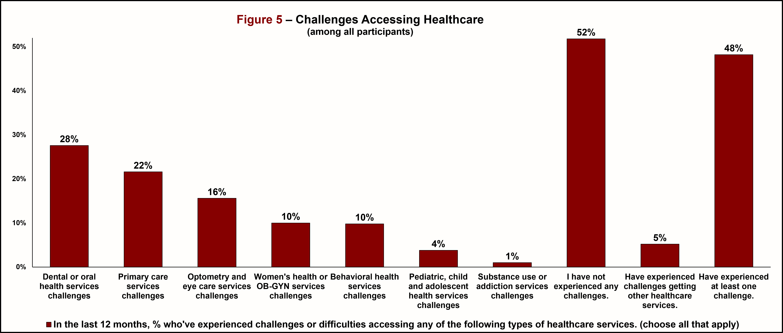
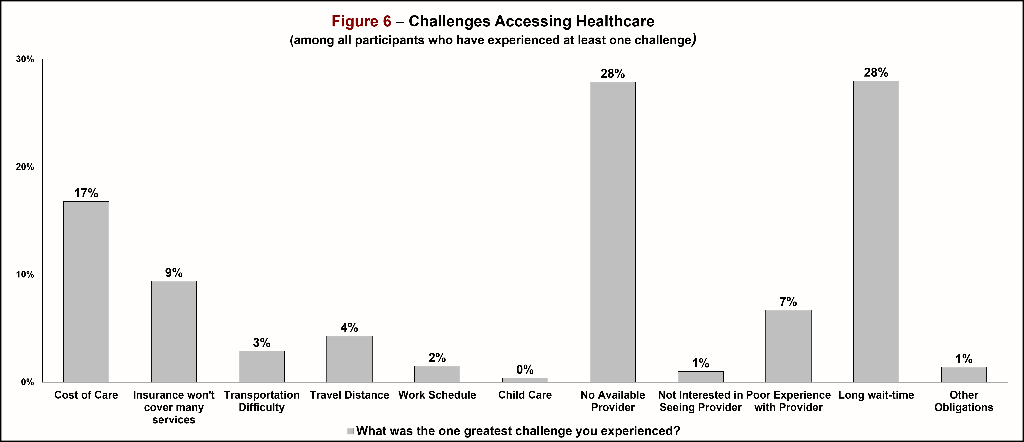
What did we learn? Challenges Accessing Healthcare in the North Country?
9 Healthcare Access Challenges Q’s included in the survey

Slide 16

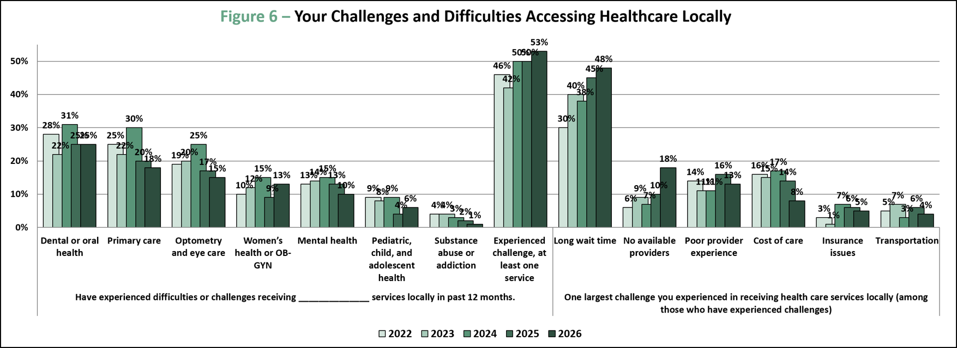
What did we learn? Challenges Accessing Healthcare in the North Country?
These 9 Healthcare Access Challenges Q’s also included in the July 2026 J-L-SL Community Health Survey

Slide 17
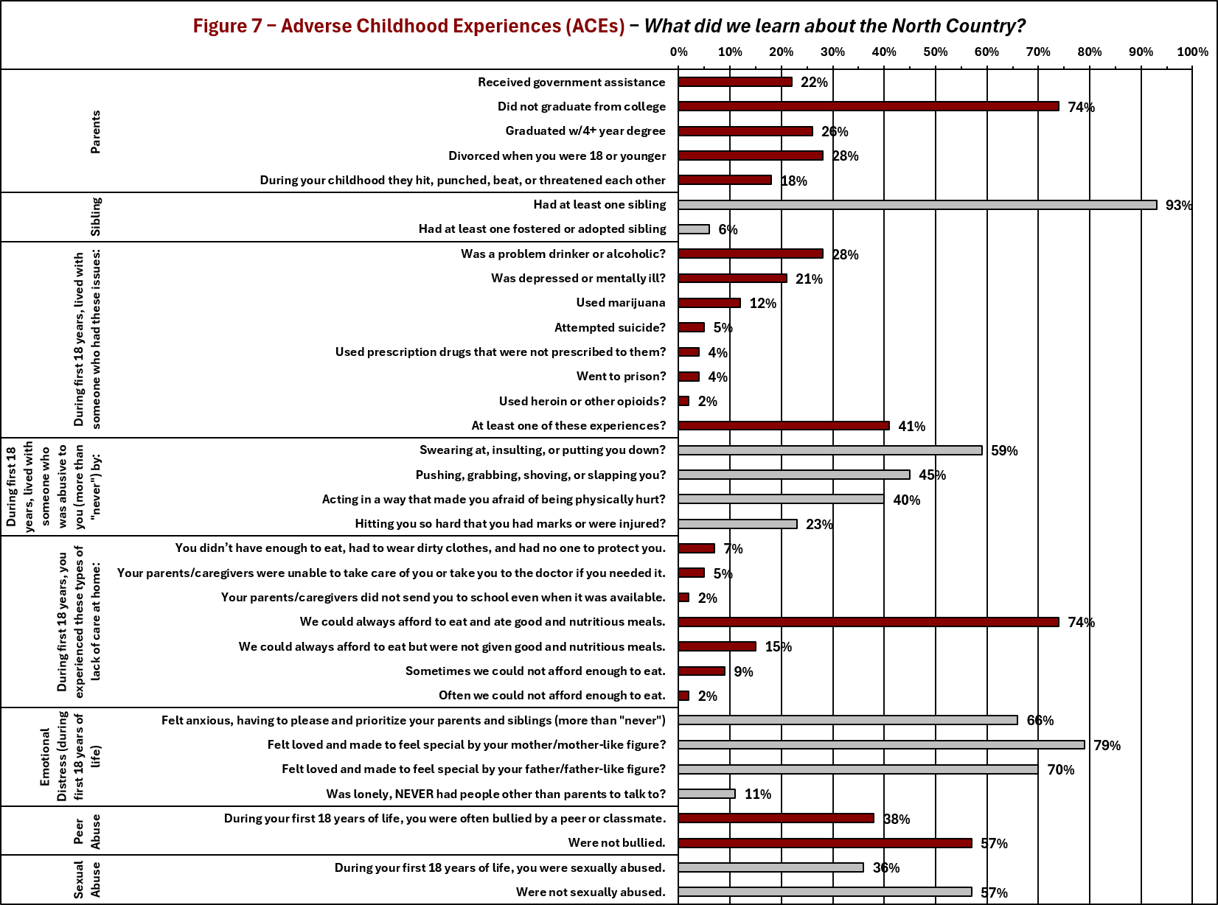
What did we learn? Adverse Childhood Experiences in the North Country, among all participants?
36 ACEs Q’s included in the survey

Slide 18
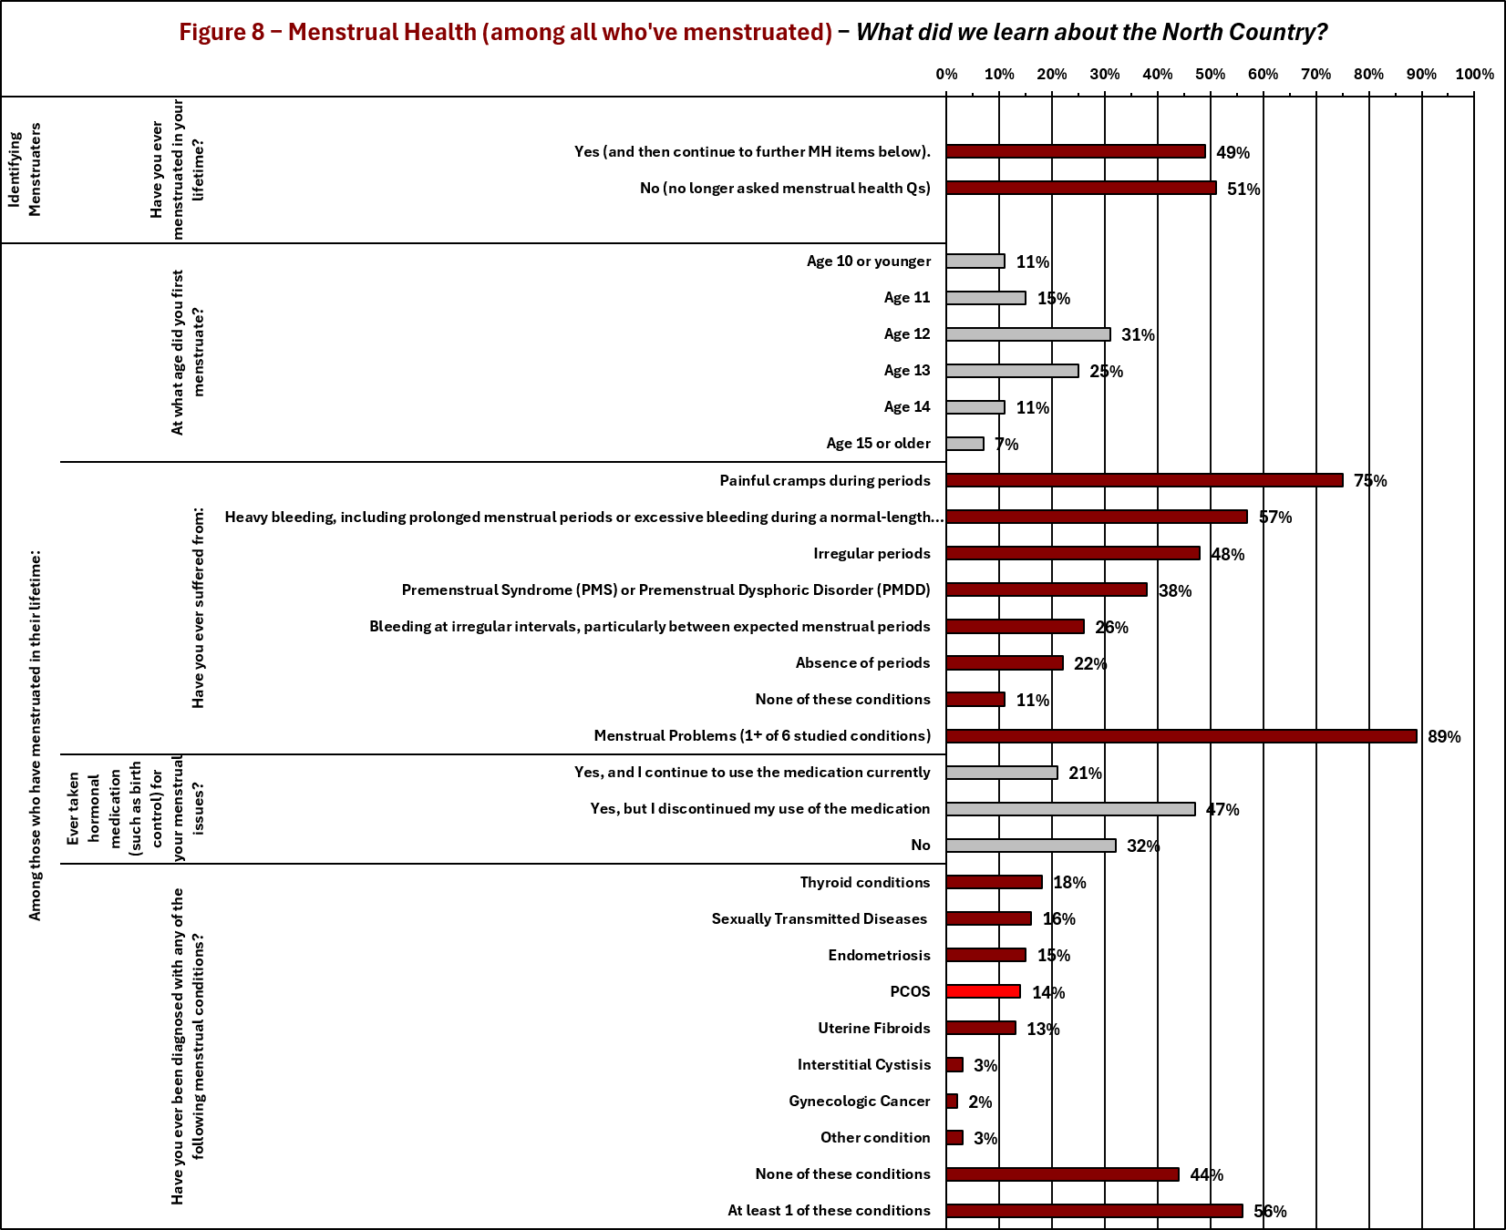
What did we learn? Menstrual Health among all menstruaters in the North Country?
20 Menstrual Health Q’s included in the survey that were posed to all menstruaters

Slide 19
What is PCOS?
Polycystic ovary syndrome (PCOS)—recently updated and referred to by major medical centers as polyendocrine metabolic ovarian syndrome (PMOS)—is a systemic hormonal and metabolic disorder affecting women of reproductive age. The updated term emphasizes that the condition involves the entire endocrine and metabolic system, rather than just the ovaries.
https://www.mayoclinic.org/diseases-conditions/pcos/symptoms-causes/syc-20353439
How common is PCOS?
The Centers for Disease Control and Prevention (CDC) estimates that Polycystic Ovary Syndrome (PCOS) affects as many as 5 million women and reproductive-aged individuals in the United States.
Key Facts on PCOS Rates:
Total Impact: This figure means roughly 6% to 12%—or about 1 in 10—women of reproductive age deal with PCOS.
Global Estimates: The World Health Organization notes similar worldwide rates, estimating that 10% to 13% of women globally have PCOS.
Underdiagnosis: Up to 70% of women who have PCOS do not know they have it because symptoms vary widely or go unrecognized.
https://wwwn.cdc.gov/Nchs/Data/Nhanes/Public/2019/DataFiles/TST_K_R.htm
https://www.who.int/news-room/fact-sheets/detail/polycystic-ovary-syndrome

Slide 20
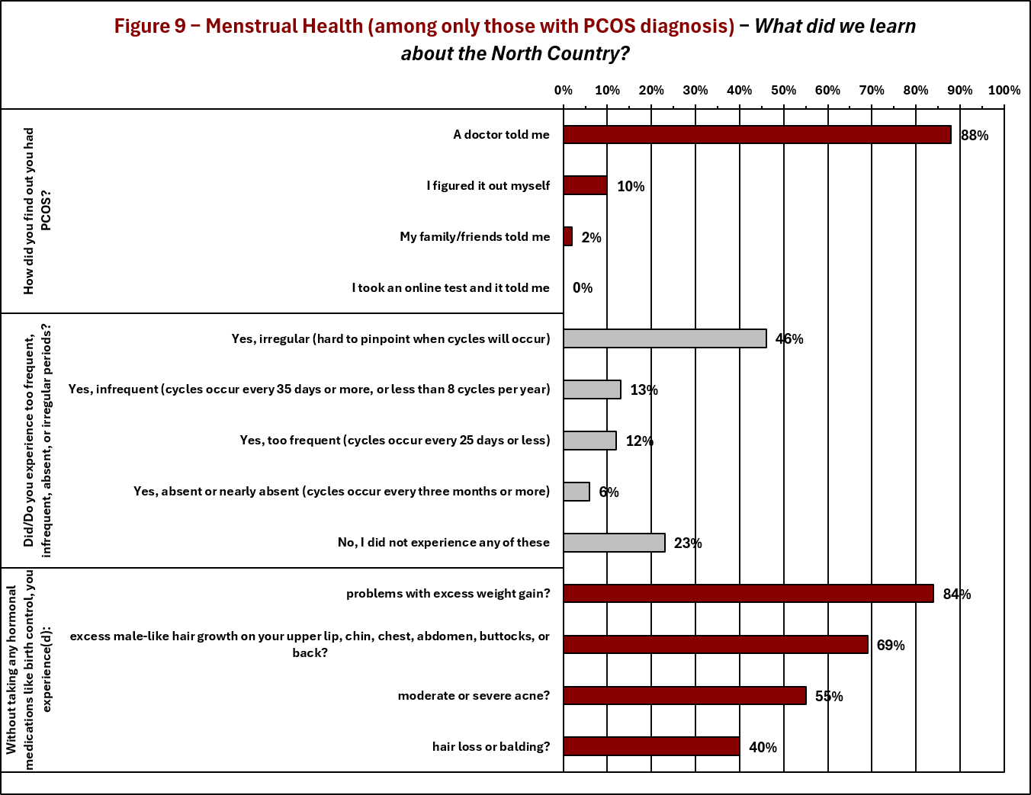
What did we learn? Menstrual Health among menstruaters who have been diagnosed with PCOS in the North Country?
6 further Menstrual Health Q’s included in the survey posed only to those with PCOD diagnosis

Slide 21
What we learned: 90+ Variables have just added to the body of knowledge regarding health and healthcare in the North Country.
However, there is so much more in this rich multivariate data set:
What can we learn from relationships among these 90+ variables? (6 sections/groups of variables)

Slide 22
Chapter 3
Adverse Childhood Experience (ACE) & Menstrual Health (MH) Metrics to reduce/collapse study results into manageable and meaningful measures. (based upon current literature and past studies)

Slide 23
Remember this? Adverse Childhood Experiences in the North Country, among all participants?
The 36 ACEs Q’s included in the survey … will now be collapsed into 6 ACE Metrics

Slide 24
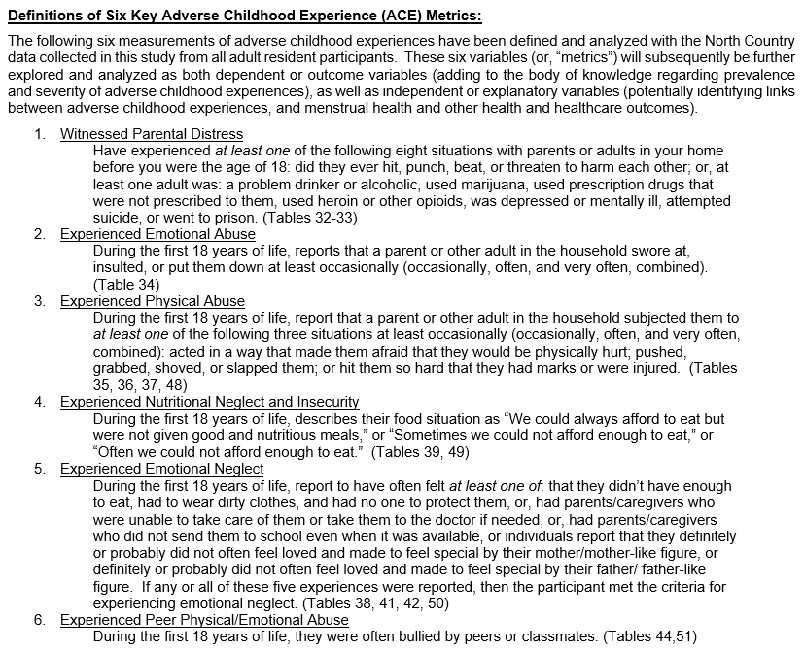
ACE Metrics

Slide 25
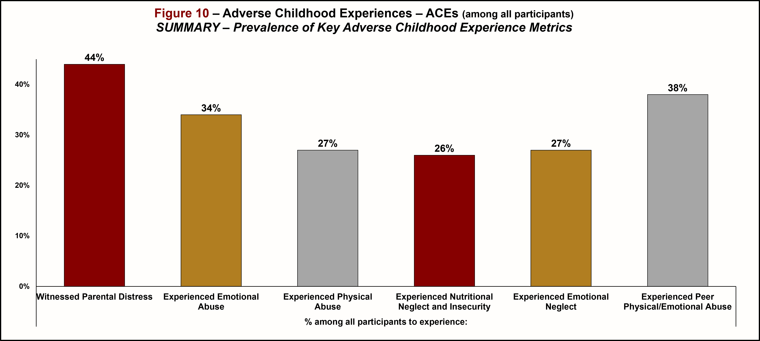
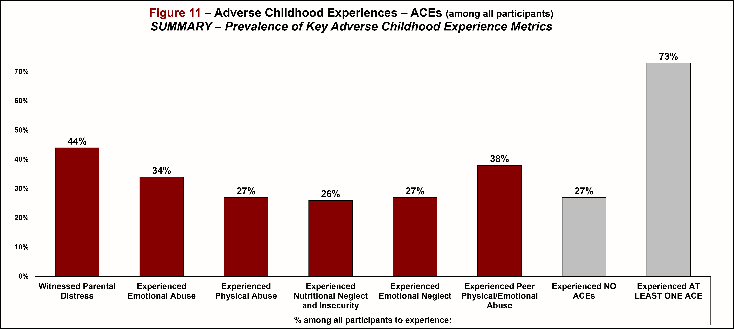
Metrics – Adverse Childhood Experiences ACEs

Slide 26
How about this? Menstrual Health in the North Country, among all menstruaters?
The 26 Menstrual Health Q’s included in the survey … will now be collapsed into 5 Menstrual Health Metrics

Slide 27
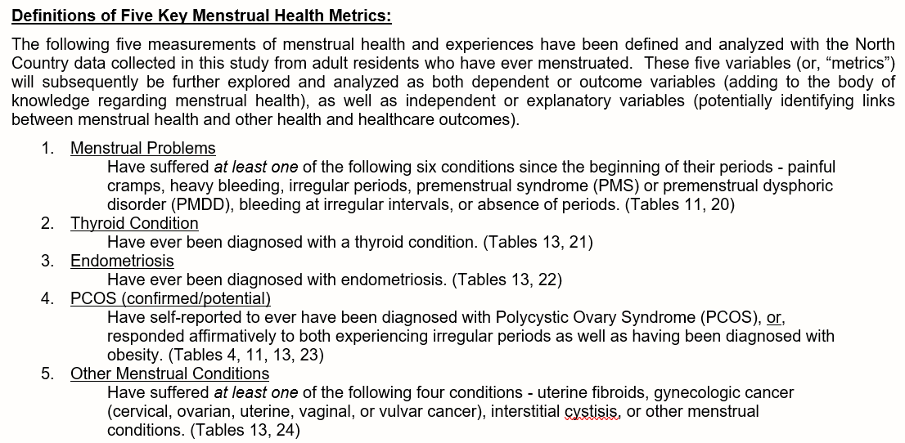
Menstrual Health Metrics

Slide 28
Metrics – Menstrual Health

Slide 29
Chapter 4
Relationships/Modeling I
Socio-Demo. & Social-Determinant of H. ↔ ACEs

Slide 30
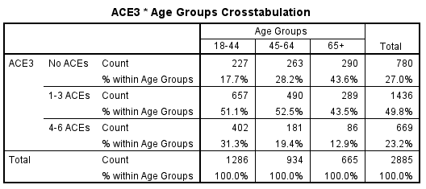
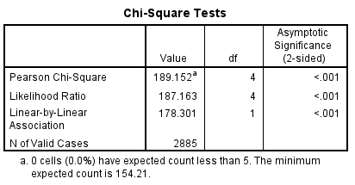
Socio-Demographics ↔ ACEs
p-value = 8.06*10⁻⁴⁰ =
0.000000000000000000000000000000000000000806

Slide 31
ACEs ↔ Socio-Demographics (reversed…Bayesian View)

Slide 32
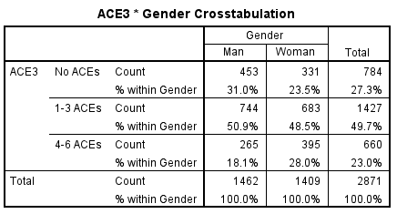
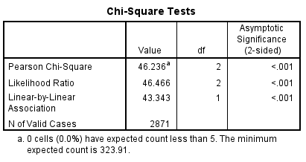
Socio-Demographics (G) ↔ ACEs
p-value = 9.12*10⁻¹¹ = 0.0000000000912

Slide 33
ACEs ↔ Socio-Demographics (G) (reversed…Bayesian View)

Slide 34
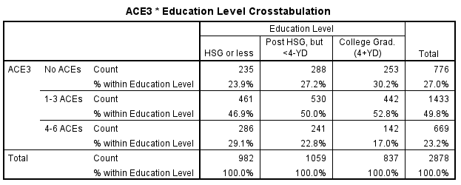

Socio-Demographics (E) ↔ ACEs
p-value = 7.93*10⁻⁸ = 0.0000000793

Slide 35
ACEs ↔ Socio-Demographics (E) (reversed…Bayesian View)

Slide 36
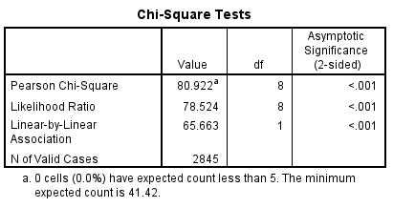
Socio-Demographics (I) ↔ ACEs
p-value = 3.19*10⁻¹⁴ = 0.0000000000000319

Slide 37
ACEs ↔ Socio-Demographics (I) (reversed…Bayesian View)

Slide 38
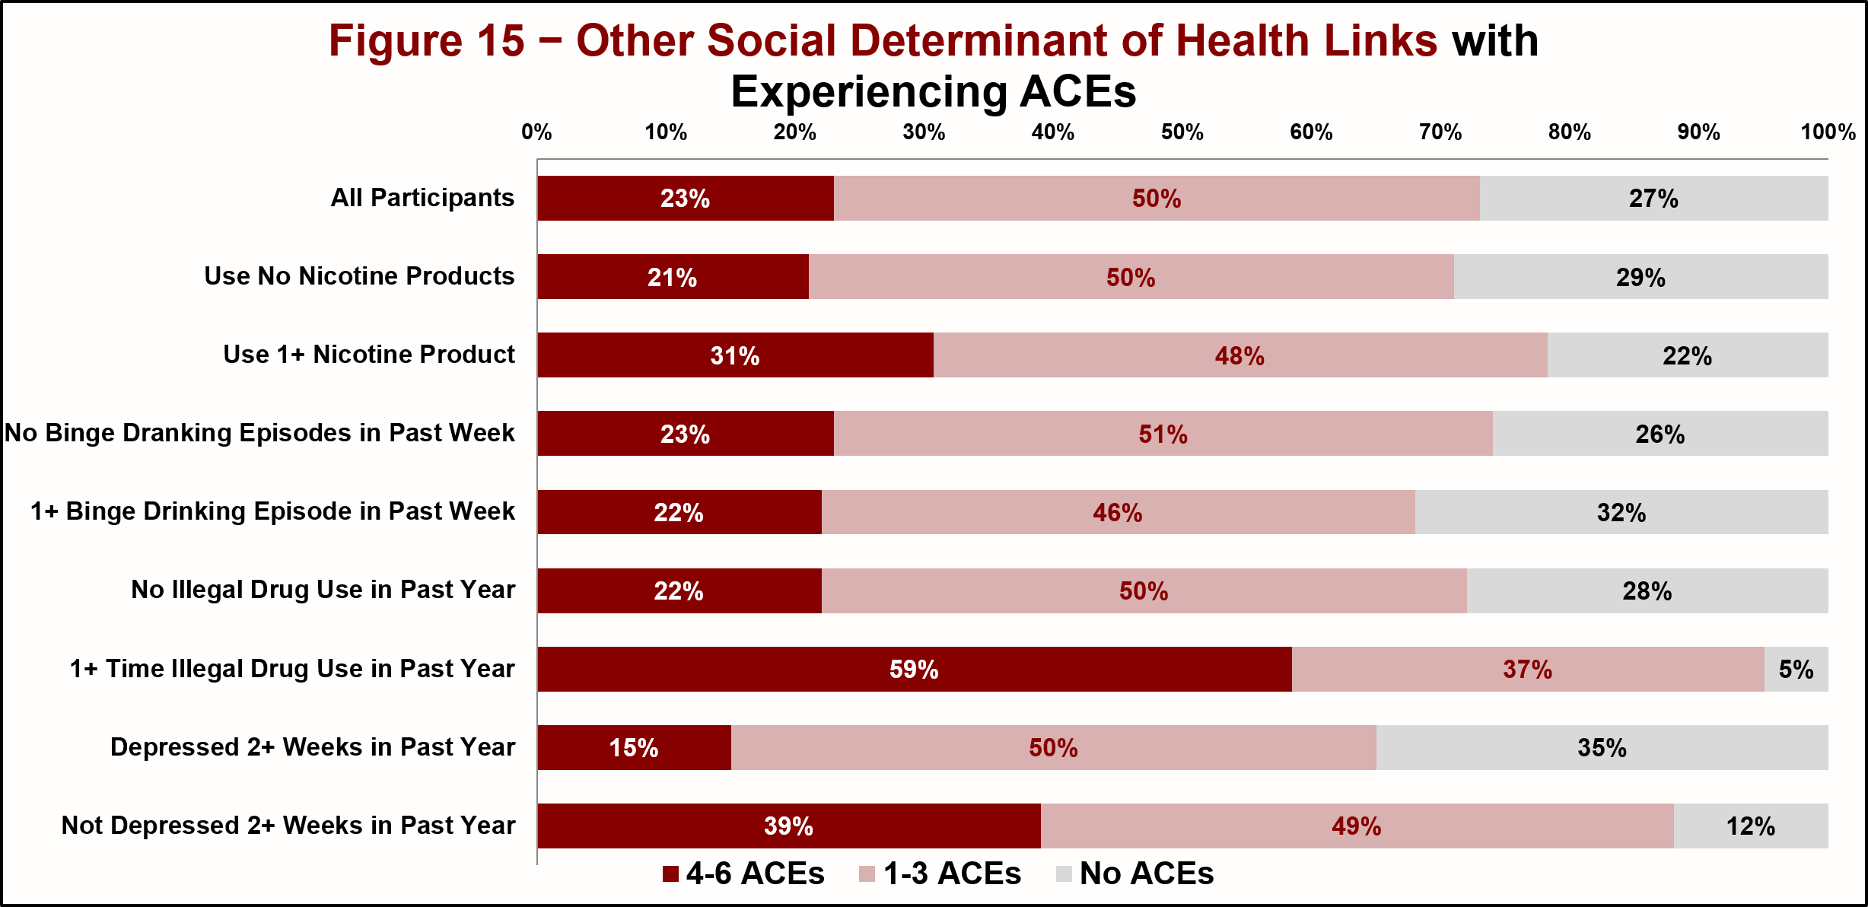
Social Determinants of H. ↔ ACEs
Social Determinant of Health | p-value (p<0.001 SS)
Nicotine Product Use | 2.10*10⁻⁸
Alcohol Abuse | 0.039 (Not SS)
Illegal Drug Use | 2.02*10⁻¹⁴
Depression | 7.07*10⁻⁶⁰

Slide 39
ACEs ↔ Social Determinants of H.

Slide 40
Chapter 5
Relationships/Modeling II
ACEs Predictive of Adult Health Conditions, Perceptions, Challenges?
ACEs → Health Conditions (perceived),
Chronic Health Conditions (diagnosed),
Healthcare Access/Challenges, Menstrual Health

Slide 41
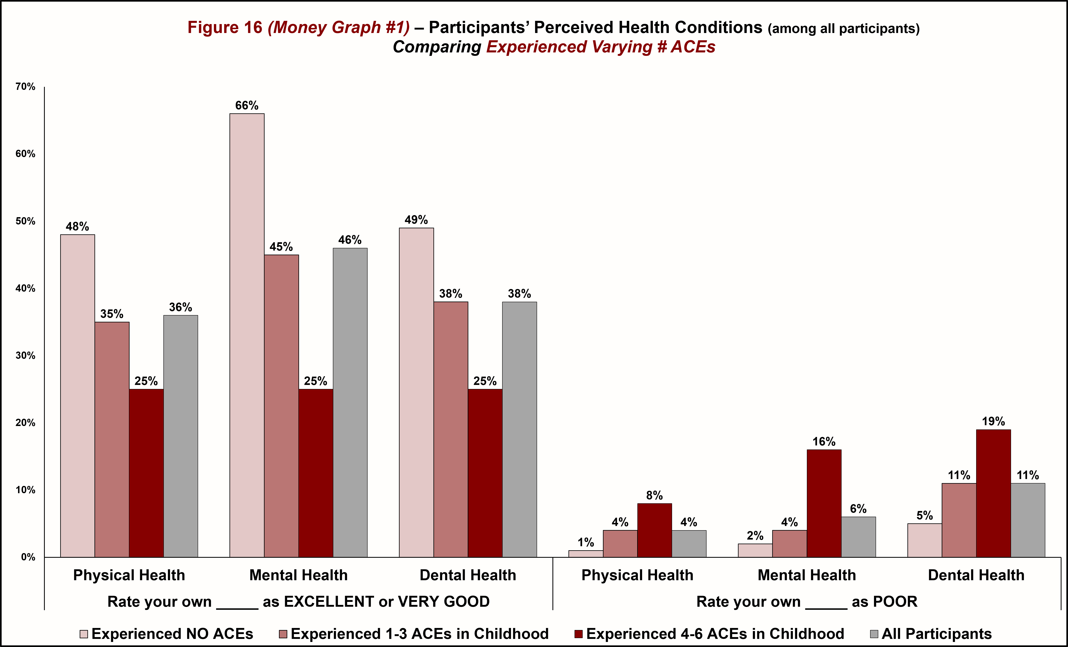
ACE Frequency ↔ Perceived Health Condition

Slide 42
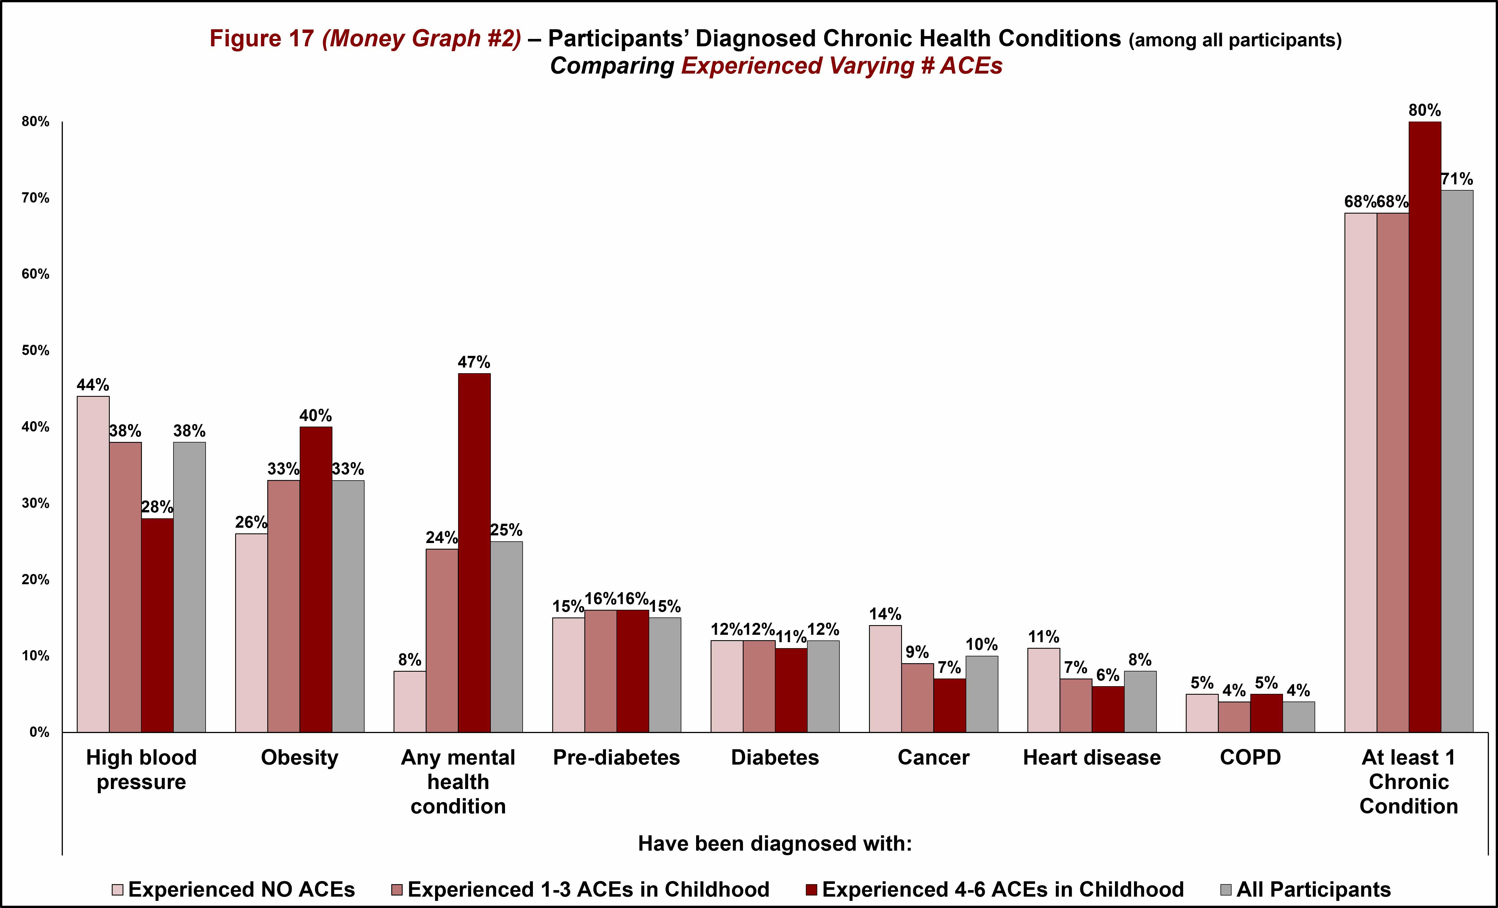
ACE Frequency ↔ Chronic Health Conditions

Slide 43
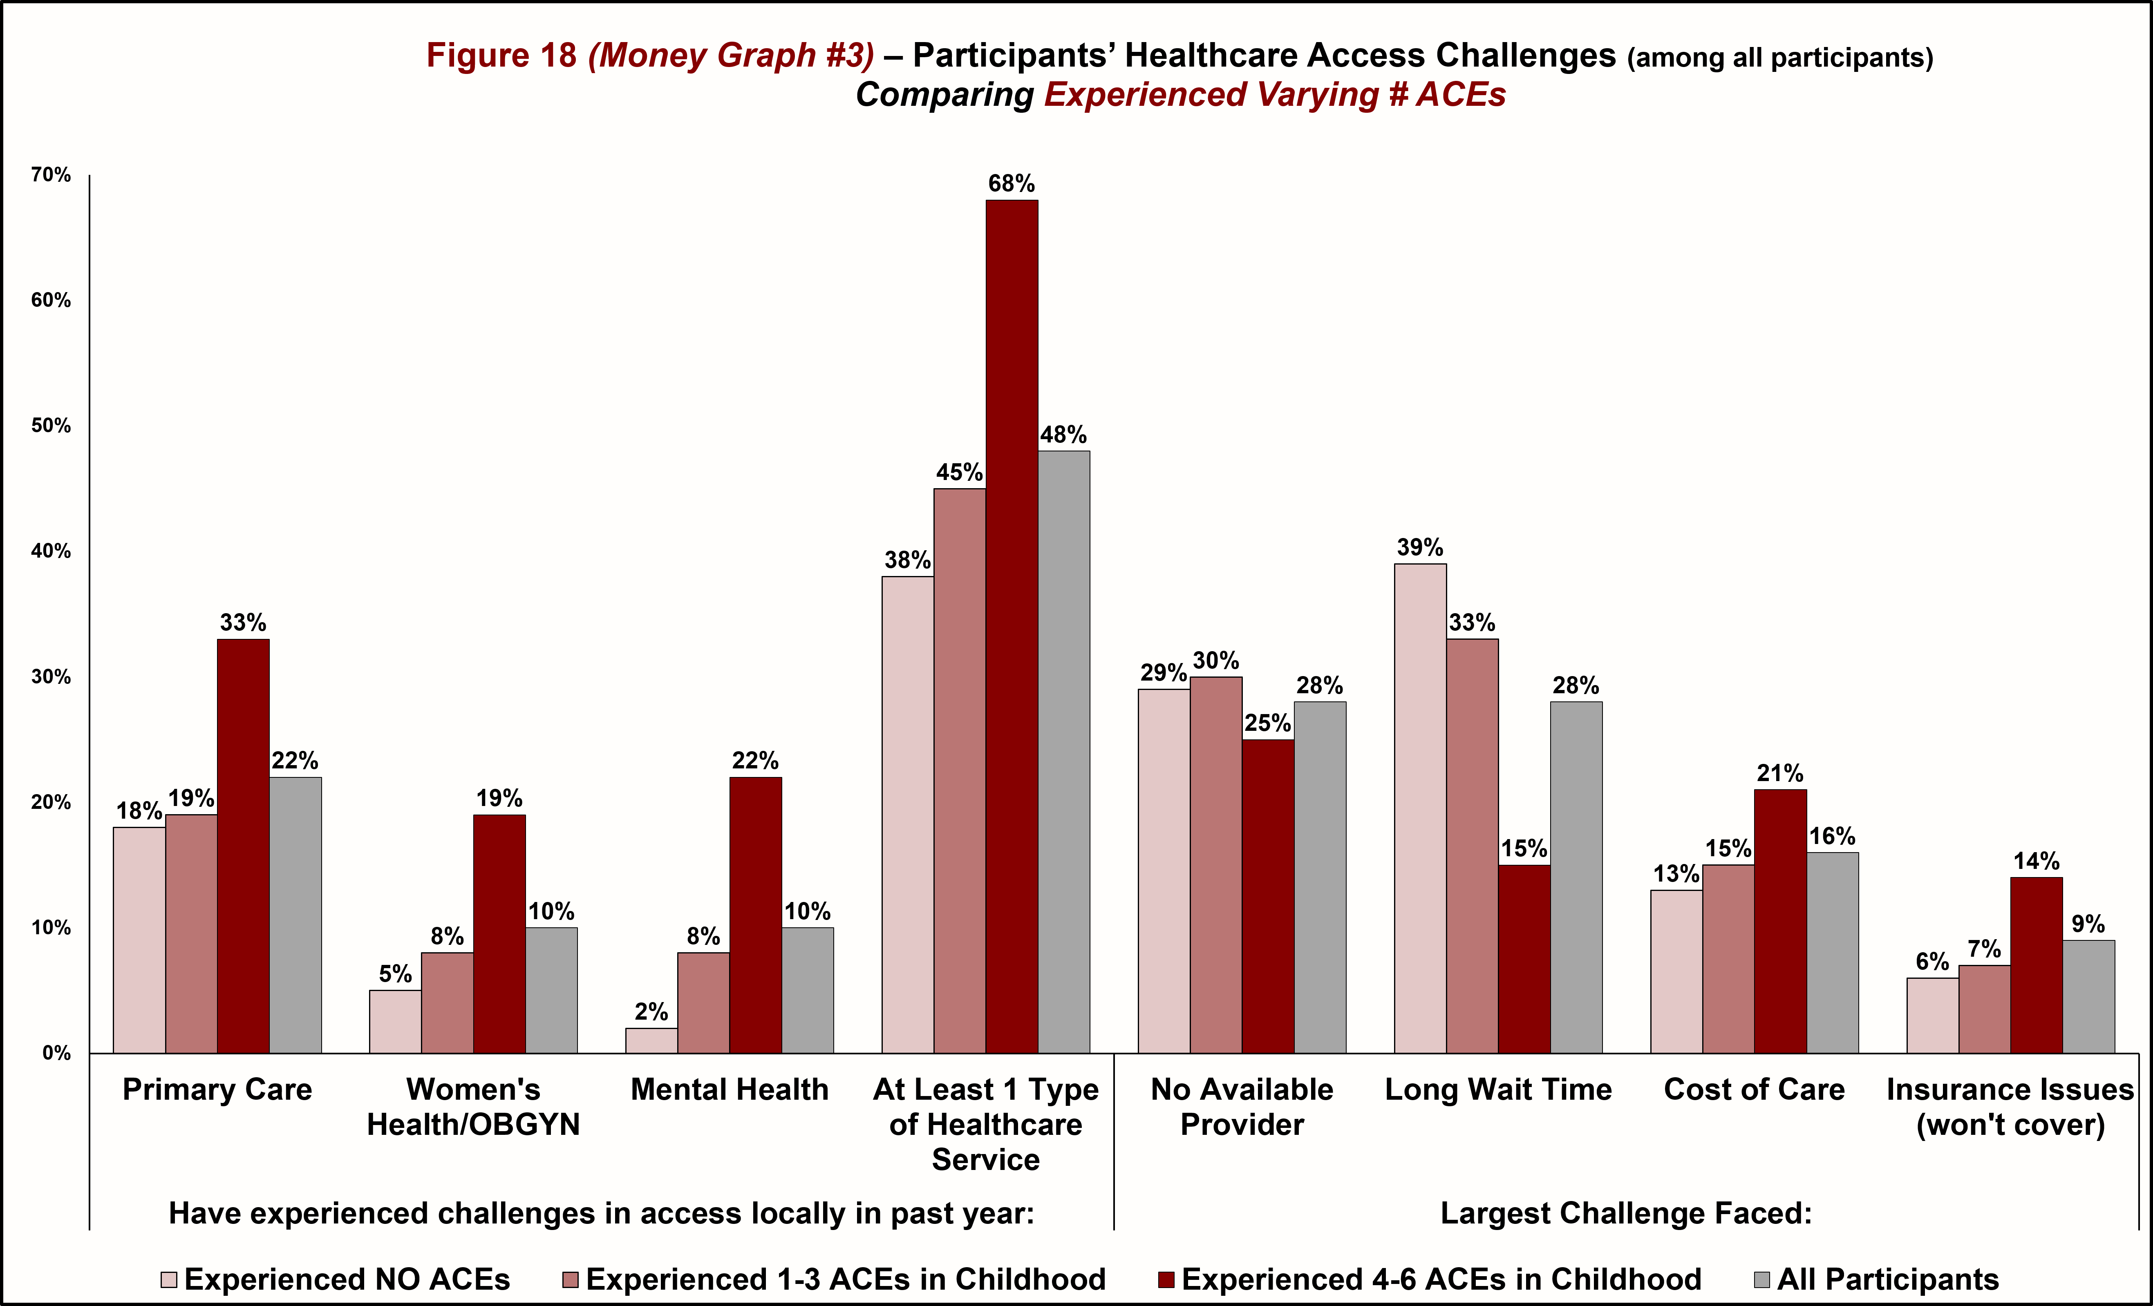
ACE Frequency ↔ Challenges Accessing HC

Slide 44
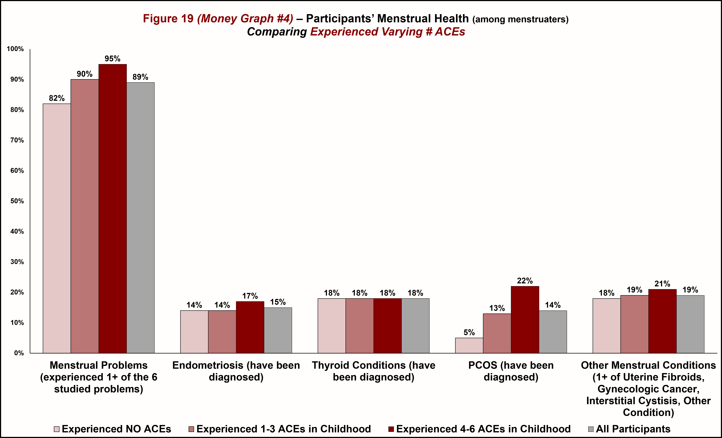
ACE Frequency ↔ Menstrual Health

Slide 45
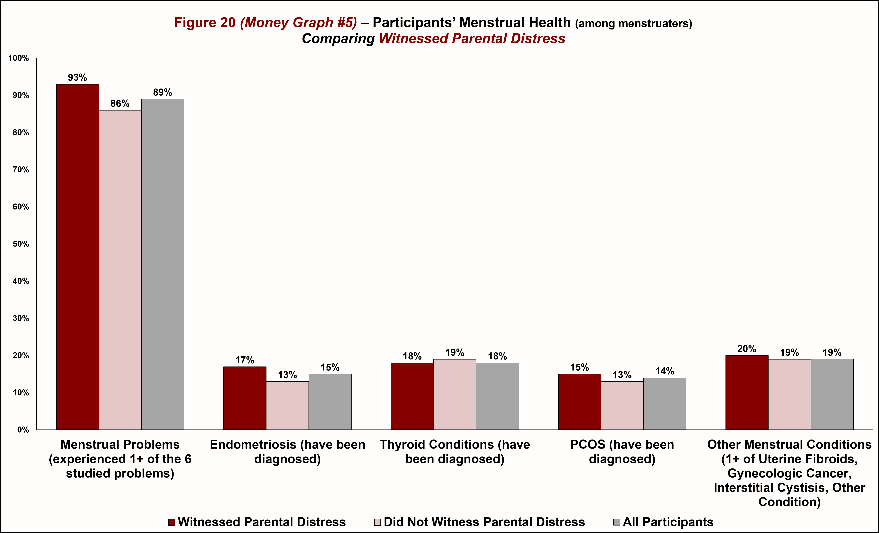
Witnessed Parental Distress ↔ Menstrual Health

Slide 46
Experienced Emotional Abuse ↔ Menstrual Health

Slide 47
Experienced Physical Abuse ↔ Menstrual Health

Slide 48
Experienced Nutritional Neglect and Insecurity ↔ Menstrual Health

Slide 49
Experienced Emotional Neglect ↔ Menstrual Health

Slide 50
Experienced Peer Physical/Emotional Abuse ↔ Menstrual Health

Slide 51
Chapter 6
Wrap Up
Summary, Take-aways, Next Steps, Q/A

Slide 52
Today’s Take-Aways :
The Story Being Described in these Chapters:
ACEs are common among NC residents.
Incidence of experiencing ACEs is greater among certain socio-demographic subgroups.
Further links between Social Determinants of Health and ACEs need continued research.
Menstrual Health Issues are common among NC menstruaters.
ACEs are strongly linked with all four of:
  Perceived Health Condition
  Chronic Health Condition Diagnoses
  Healthcare Access Challenges
  Menstrual Health, especially PCOS and menstrual irregularity

Slide 53
Next Steps:
Let’s have a conversation … please do ask us any questions that you may have.
Our future research plan …

Slide 54
Thanks for caring.
We can do better.
Dr. Akanksha Misra
SUNY Plattsburgh
amisr001@plattsburgh.edu
Mr. Joel LaLone
SUNY Jefferson
jlalone@sunyjefferson.edu

